Slide 1
Hypothesis Testing for Slope
Refer to the daily sales-advertising data of a chocolate store presented in the table.
Conduct a hypothesis test (at α = 0.05) to determine if sales (y) is positively linearly related to advertising expenditure.
Sales | Advertisement
1097 | 50
1187 | 100
1152 | 75
1112 | 50
1131 | 60
1157 | 70
1128 | 75
1197 | 100
1170 | 80
1139 | 75

Slide 2
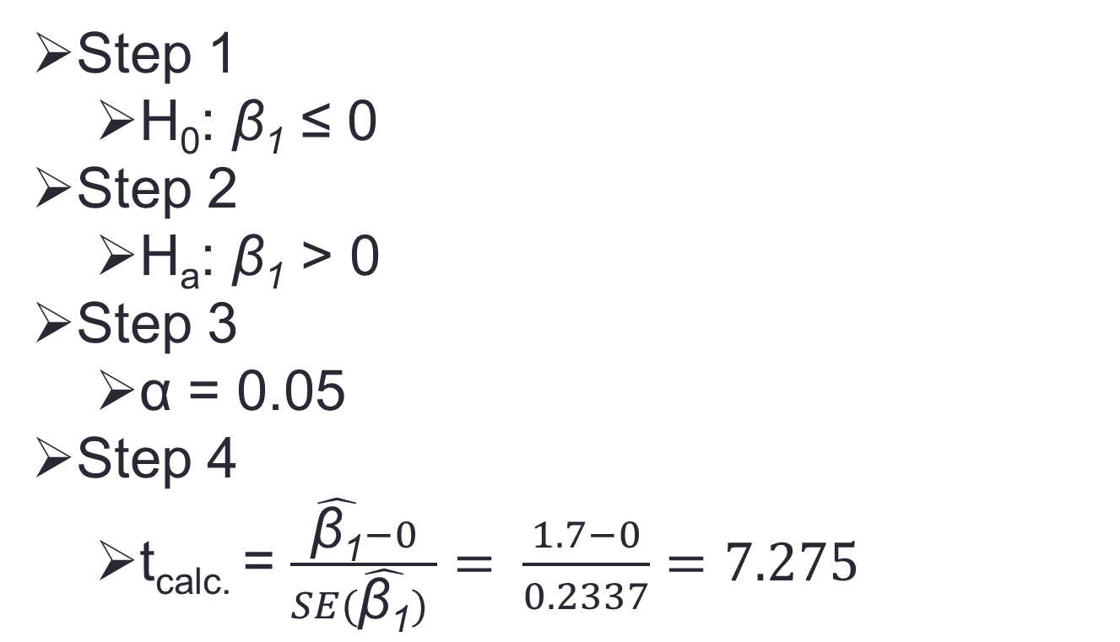
Hypothesis Testing for Slope
Step 1
H₀: β₁ ≤ 0
Step 2
H_{a}: β₁ > 0
Step 3
α = 0.05
Step 4
t_{calc.} = $\frac{\hat{\text{β}\text{1}}−0}{SE(\hat{\text{β}\text{1}}) }= \frac{1.7−0}{0.2337}=7.275$

Slide 3
Hypothesis Testing for Slope
Step 5
Rejection Rule: Is t_{calc.} > t_{α}?
Rejection Rule: Is p-value < α?
Step 6
t_{α} = 1.86 (degrees of freedom = n-2 = 8)
Since t_{calc.} (7.275) is greater than t_{α}(1.86), reject the null hypothesis.
Step 7
At a significance level of 0.05, there is statistical evidence to show that sales and advertising are linearly related.

